Slide 1

CAST-128
Encryption Algorithm
Mati Halfa | Arkady Koretsky | Shoham Gamliel
204190516 | 311008361 | 316311547

Slide 2
Introduction
CAST is a design procedure for symmetric encryption algorithms developed by Carlisle Adams and Stafford Tavares
Feistel Network structure
Operating on 64-bit blocks of plaintext
Key size which can vary from 40 bits to 128 bits

Slide 3
Introduction
CAST-128 belongs to the class of encryption algorithms known as Feistel ciphers; overall operation is thus similar to the Data
Encryption Standard (DES).
INPUT: plaintext m1...m64; key K = k1...k128.
OUTPUT: ciphertext c1...c64.

Slide 4
Variable Keysize
For key sizes up to and including 80 bits (i.e., 40, 48, 56, 64,72, and 80 bits) uses 12 rounds
For key sizes greater than 80 bits, the algorithms uses the full 16 rounds
For key sizes less than 128 bits, the key is padded with zero bytes (in the rightmost, or least significant, positions)

Slide 5
Example
40-bit key = 01 23 45 67 12
= 01 23 45 67 1200 00 00 00 00 00 00 00 00 00 00

Slide 6
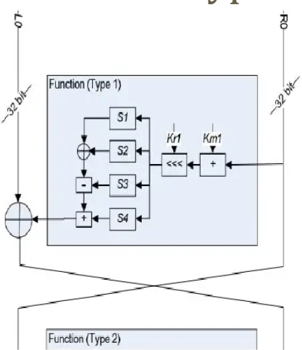
Function Type 1
Function Type 1: I = ((Kmi + D) <<< Kri) f = ((S1[Ia] ^ S2[Ib]) - S3[Ic]) + S4[Id]
Rounds 1, 4, 7, 10, 13, and 16 are used

Slide 7
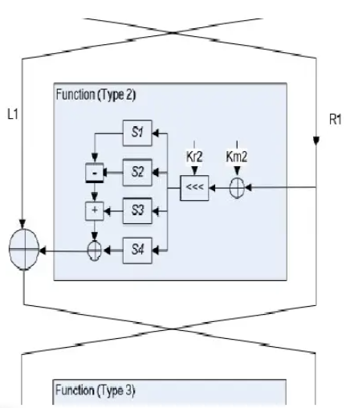
Function Type 2
Function Type 2: I = ((Kmi ^ D) <<< Kri) f = ((S1[Ia] - S2[Ib]) + S3[Ic]) ^ S4[Id]
Rounds 2, 5, 8, 11, and 14 are used

Slide 8
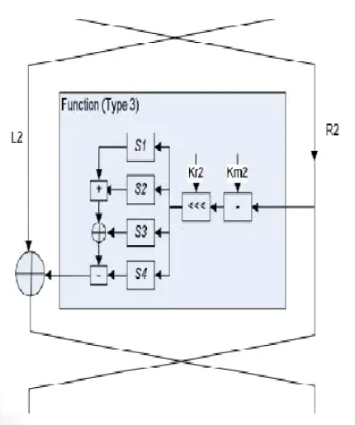
Function Type 3
Function Type 3: I = ((Kmi-D) <<< Kri)
f = ((S1[Ia] + S2[Ib]) ^ S3[Ic]) - S4[Id]
Rounds 3, 6, 9, 12, and 15 are used

Slide 9
Algorithm
Km is used as a “masking” key.
Kr is used as a “rotation” key.
D is the data input to the f function.
Ia, Ib, Ic, Id are the most significant byte down to the least significant byte of I, respectively.
S1, S2, S3, S4 are Sbox 1, 2, 3 and 4.
i is the round number.
“+” and “-” are addition and subtraction.
“^” is bitwise exclusive or (xor).
“<<<“ is a circular left shift operation.

Slide 10
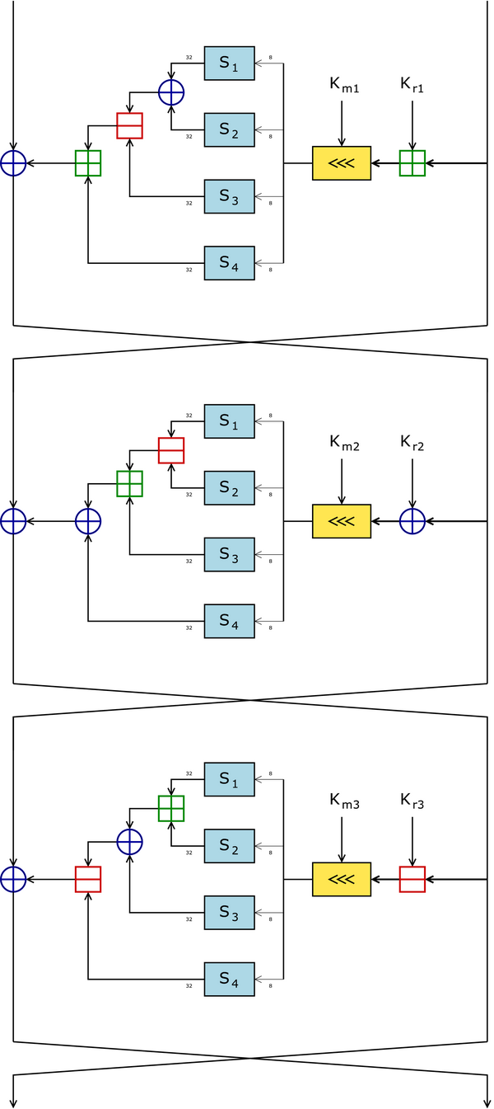
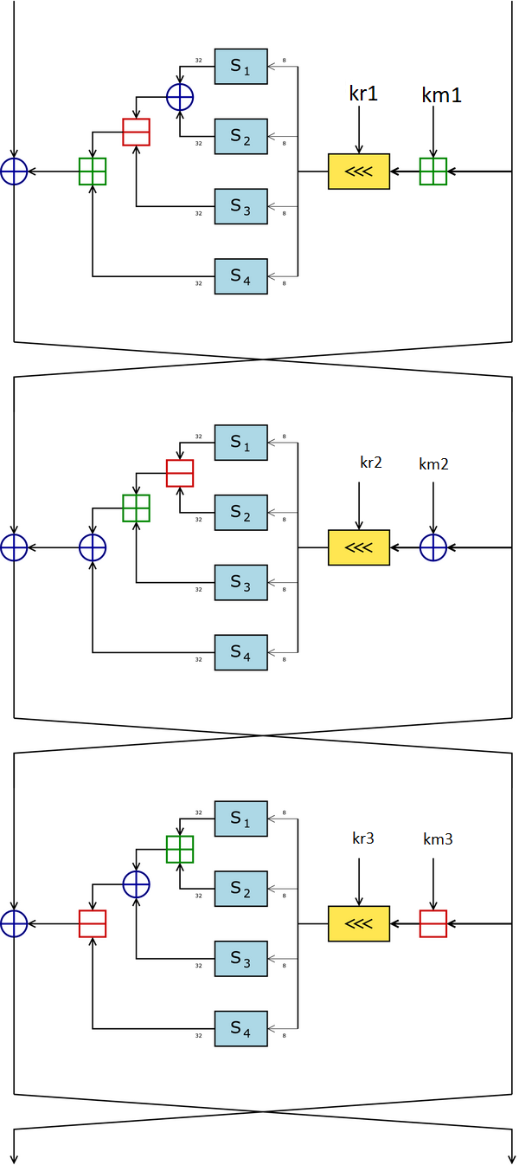
Algorithm
Ri-1
Li-1
f
Ri
Li = Ri-1; Ri = Li-1 ^ f(Ri-1,Kmi,Kri)
Li
Ri
Type 1: I = ((Kmi + D) <<< Kri) f = ((S1[Ia] ^ S2[Ib]) - S3[Ic]) + S4[Id] Type 2: I = ((Kmi ^ D) <<< Kri) f = ((S1[Ia] - S2[Ib]) + S3[Ic]) ^ S4[Id] Type 3: I = ((Kmi - D) <<< Kri) f = ((S1[Ia] + S2[Ib]) ^ S3[Ic]) - S4[Id]
Li
f
Ri+1
Li+1
Ri+1
Li+1
c1...c64 <-- (R16,L16): Exchange final blocks L16, R16 and concatenate to form the ciphertext.
f
Ri+2
Li+2

Slide 11
Substitution box
It is 32 X 8 S-box
Each value at the S-box is 4 bytes
Have 8 S-boxes
For S1 to S4 uses for encryption and decryption process
For S5 to S8 uses for key scheduling

Slide 12
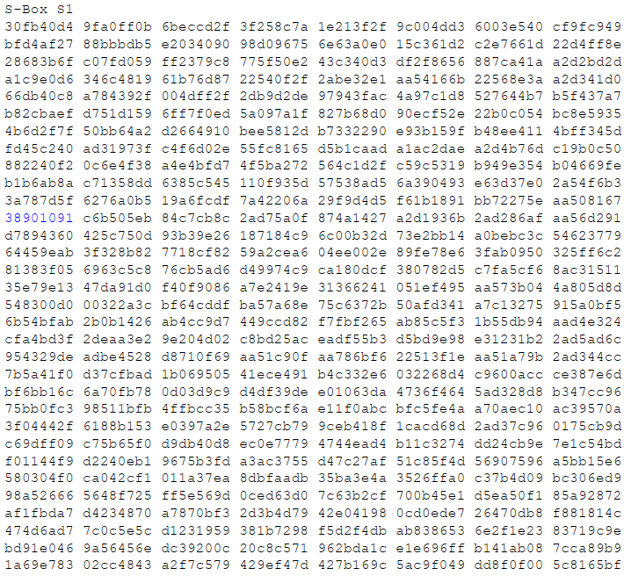
Example of s-box s1

Slide 13
Key scheduling
K1-K16 are used in their entirety. The set of K1-K16 is called Km (m for "masking")
Only the least significant 5 bits of K17-K32 are used (Since there are only 32 bits, only 5 bits are needed for the rotations. Any more is useless). This set is called Kr (r for "rotation")
Notes:
הגודל של Kr (מספר הפעמים שעושים Shift Left) הוא 5 ביטים בלבד מכיוון שהמספר הגדול ביותר שניתן לייצג ב-5 ביטים הוא 31. אם ניקח כבר 32, זה אומר שתהיה לנו אפשרות לעשות 32 Shift Left על מספר שיש בו רק 32 ביטים ואז זה אומר שהמספר Kmi + D מתאפס – בסופו של דבר אין לנו כוונה שזה יתאפס.

Slide 14
Key scheduling
Let the 128-bit key be x0x1x2x3x4x5x6x7x8x9xAxBxCxDxExF, where x0 represents the most significant byte and xF represents the least significant byte.
Let z0..zF be intermediate (temporary) bytes.
Let Si[] represent s-box i and let "^" represent XOR addition.

Slide 15
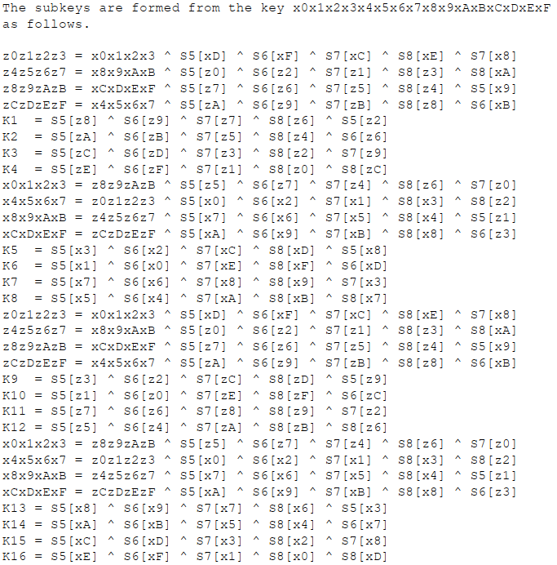
Key scheduling
S5 – S8 are the S-box for these operations

Slide 16
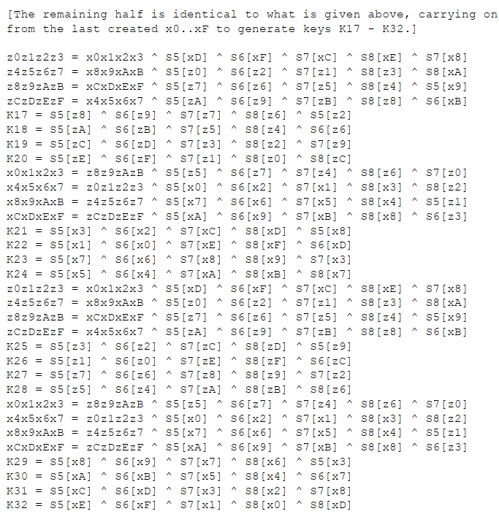
Key scheduling
S5 – S8 are the S-box for these operations
Notes:
בסבב השני של יצירת המפתחות, מפתחות 17-32, הערכים x0x1x2…xF כבר לא מייצגים את ה-main key כי הם עברו שינויים בסבב הקודם.
פרט לקוח כל החישובים, אותם חישובים.

Slide 17
What about decryption?
Decryption is identical to the encryption algorithm given above, except that the rounds (and therefore the subkey pairs) are used in reverse order to compute (L0,R0) from (R16,L16).
Km 16 Kr 16
Km 15 Kr 15
Km 1 Kr 1

Slide 18
Thanks You For Listening!

Slide 19
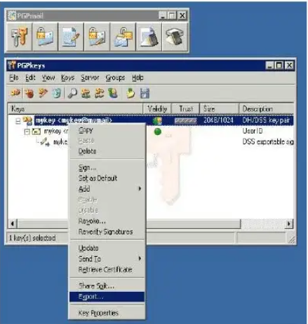
What is pgp?
Stand for Pretty Good Privacy.
Software that provides confidential, authentication and integrity service fore-mail and file storage applications.
Based on the best algorithms available.
Notes:
PGP
PGP הוא קיצור של Pretty Good Privacyונוצר ב1991 והוא לוקח את הרעיון של Web Of Trust שאומר שמשתמש הקצה לא צריך להחזיק שרת תעודות על מנת לאמת \ לזהות\ להצפין את המידע ובכך לאמת\ לחתום\ להצפין מידע
PGP מכיל יכולות כמו
Hashing
Data Compression
PKI
Symmetric Key

